Slide 1
Computer Graphics labs
Lab 2 - More Shaders + Buffers

Slide 2
Uniforms

Slide 3
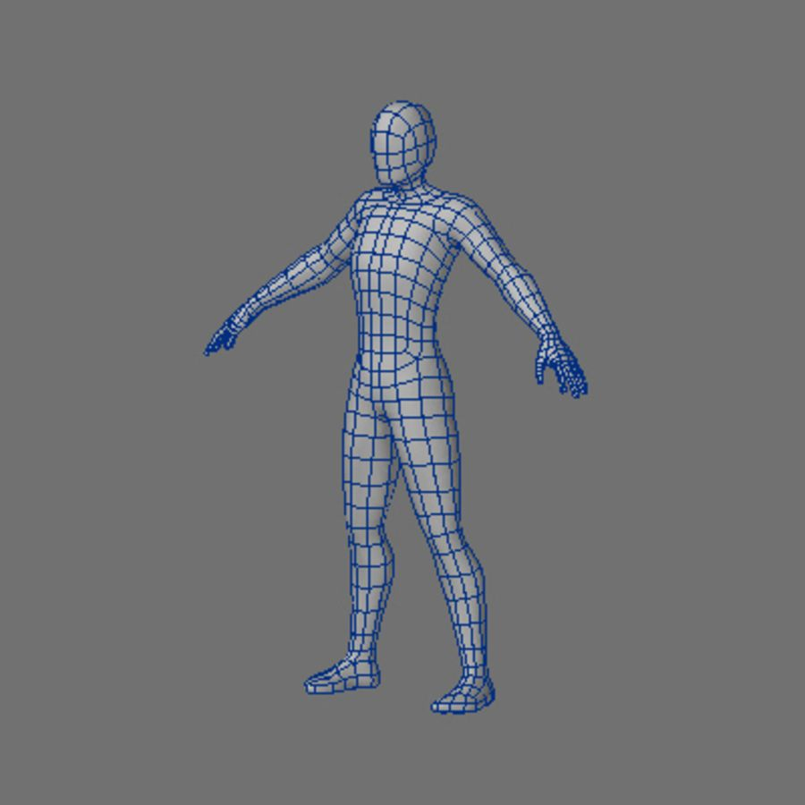
Let’s see what kind of Data used by shaders
Static data
Dynamic data
Doesn’t change every frame.
Change every frame.
Like the positions of vertices in a 3d model.
Like the position of the object in the screen.

Slide 4
Let’s see what kind of Data used by shaders
Static data
Dynamic data
More amount of data.
Less amount of data.
Not good to send the data every frame to the GPU performance wise.
Can be sent every frame to the GPU.

Slide 5
The dynamic data is called “Uniform”
To set a uniform:
// Get the address to the program variable "scale" found
// in vertex shader "quad.vert file".
GLuint scale_uniform_location = glGetUniformLocation(program, "scale");
glUniform2f(scale_uniform_location, scale.x, scale.y);

Slide 6
In the shader
uniform vec2 scale;

Slide 7
Ex 03 demo

Slide 8
2. Varyings

Slide 9
Recap on Program
010011001010010110101010100101100100011010101010
010011001010010110101010100101100100011010101010
010011001010010110101010100101100100011010101010
Link
Link
Another
Optional Shader
Vertex Shader
Fragment Shader

Slide 10
Some Data could be sent from the vertex shader to the Fragment shader
Vertex Shader.
Fragment Shader.
out vec4 vertex_color;
in vec4 vertex_color;

Slide 11
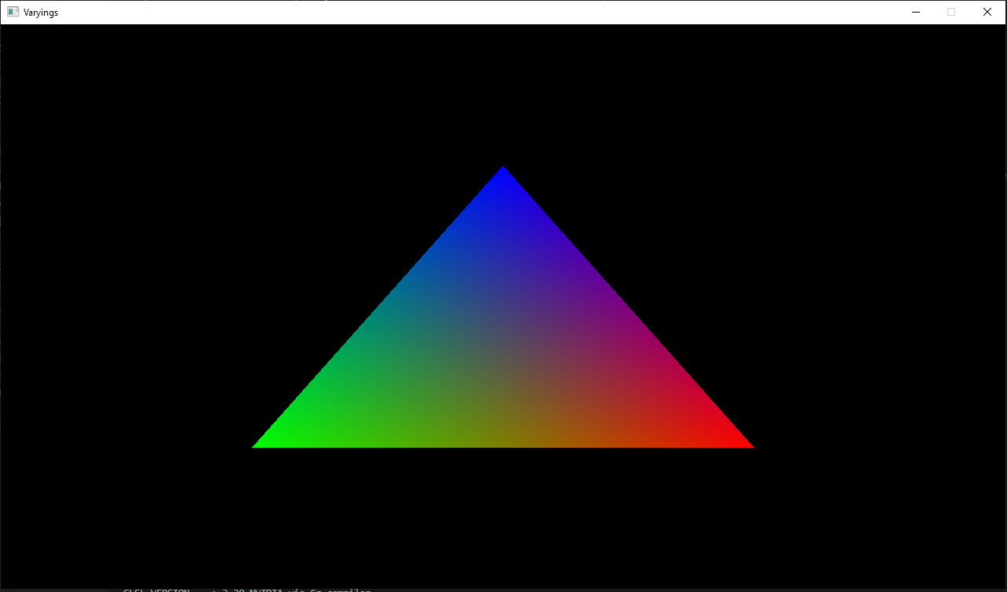
Notes:
Note that we only send 3 colors but the rasterizer interpolates them to get values for the other fragments

Slide 12
Vertex has:
Position
Color

Slide 13
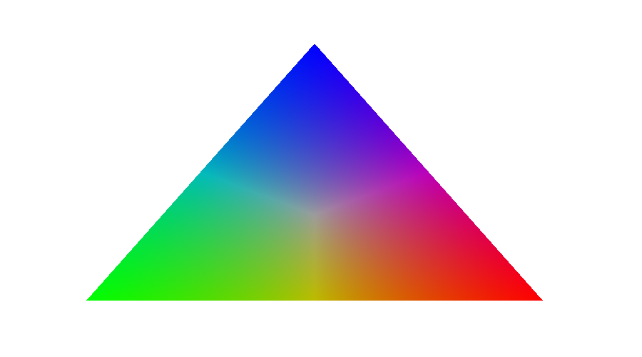
Barycentric Coordinates
A
B
Z
These coordinates defines how near we are to a vertex of the triangle.
There are 3 barycentric coordinates and their sum is always equal 1.
If all of them are within the range [0,1], then we are inside the triangle.
u = ZBC / ABC
v = AZC / ABC
w = ABZ / ABC
C_{Z} = uC_{A} + vC_{B} + wC_{C}
C

Slide 14
3. Attributes

Slide 15


RAM
VRAM
Driver
Our C++ Code
Our Shaders

Slide 16
A Buffer is just a blob of bits. It has no meaning on its own.
0
1
0
1
1
0
0
We need to tell OpenGL interpret these bits

Slide 17
During Initialization Phase
Triangle data buffer
1. Allocate a buffer and get its address.
2. Fill this buffer with the required data.
But how the GPU will deal with the data.

Slide 18
Vertex and fragment shaders in the pipeline
Vertex Data
Vertex Shader
Primitive Assembly
Rasterization
Fragment Shader
Frame Buffer

Slide 19
Say Hello to
VERTEX ARRAY
ATTRIBUTE
BUFFER
ATTRIBUTE
BUFFER
ATTRIBUTE
BUFFER
VERTEX ARRAY
ATTRIBUTE

Slide 20
During Initialization Phase
Shader program
Triangle data buffer
3. Send the shaders to the GPU.
4. Compile the shaders.
5. Link the shaders in one program.
1. Allocate a buffer and get its address.
2. Fill this buffer with the required data.
1. Create Vertex Array
2. Tell it how to read the buffer

Slide 21
During Game Loop Phase
Shader program
1. Use the program.
2. Bind the vertex array.
3. Draw using selected program.
4. Unbind the vertex array.
5. Repeat from 1.

Slide 22
Buffer 1
(Triangle Mesh)
Program 1
(Shiny)
Use
Buffer 2
(Cube Mesh)
Program 2
(solid)
Bind
Buffer 3
(Sphere Mesh)
Program 3
Semi-transparent

Slide 23
Shader Attributes
#version 330 core
layout(location = 0) in vec3 position;
void main() {
gl_Position = vec4(position, 1.0);
}

Slide 24
Data needed to be passed to the GPU
float positions[] = {
-0.5, -0.5, 0.0, 0.5, -0.5, 0.0, 0.0, 0.5, 0.0
};

Slide 25
Generate and bind vertex array
glGenVertexArrays(1, &vertex_array);
glBindVertexArray(vertex_array);

Slide 26
Generate a buffer to save an array
glGenBuffers(1, &vertex_buffer);
glBindBuffer(GL_ARRAY_BUFFER, vertex_buffer);
glBufferData(GL_ARRAY_BUFFER, 3*3*sizeof(float), positions, GL_STATIC_DRAW);
Type of buffer
Size of data in bytes
Array to be saved in buffer

Slide 27
These data need to be used by the shader
GLuint position_attribute_location = glGetAttribLocation(program, "position");
std::cout << "Position Attribute Location: " << position_attribute_location << std:: endl;
glVertexAttribPointer(position_attribute_location, 3, GL_FLOAT, false, 0, (void*)0);
glEnableVertexAttribArray(position_attribute_location);
glBindVertexArray(0);
Vertex Array will store these commands as configuration

Slide 28
Data needed to be passed to the GPU
glVertexAttribPointer(Position_attribute_location, 3, GL_FLOAT, false, 0, (void*)0);
#version 330 core
layout(location = 0) in vec3 position;
void main() {
gl_Position = vec4(position, 1.0);
}
Vertex Shader
Notes:
The function glVertexAttribPointer has quite a few parameters so let's carefully walk through them:
The first parameter specifies which vertex attribute we want to configure.
The next argument specifies the size of the vertex attribute. The vertex attribute is a vec3 so it is composed of 3 values.
The third argument specifies the type of the data which is GL_FLOAT (a vec* in GLSL consists of floating point values).
The next argument specifies if we want the data to be normalized. If we're inputting integer data types (int, byte) and we've set this to GL_TRUE, the integer data is normalized to 0 (or -1 for signed data) and 1 when converted to float. This is not relevant for us so we'll leave this at GL_FALSE.
The fifth argument is known as the stride and tells us the space between consecutive vertex attributes. Since the next set of position data is located exactly 3 times the size of a float away we specify that value as the stride. Note that since we know that the array is tightly packed (there is no space between the next vertex attribute value) we could've also specified the stride as 0 to let OpenGL determine the stride (this only works when values are tightly packed). Whenever we have more vertex attributes we have to carefully define the spacing between each vertex attribute but we'll get to see more examples of that later on.
The last parameter is of type void* and thus requires that weird cast. This is the offset of where the position data begins in the buffer. Since the position data is at the start of the data array this value is just 0. We will explore this parameter in more detail later on

Slide 29
Data needed to be passed to the GPU
glVertexAttribPointer(Position_attribute_location, 3, GL_FLOAT, false, 0, (void*)0);
float positions[] = {
-0.5, -0.5, 0.0,
0.5, -0.5, 0.0,
0.0, 0.5, 0.0
};
Type
Not normalized
Notes:
The function glVertexAttribPointer has quite a few parameters so let's carefully walk through them:
The first parameter specifies which vertex attribute we want to configure.
The second argument specifies the size of the vertex attribute. The vertex attribute is a vec3 so it is composed of 3 values.
The third argument specifies the type of the data which is GL_FLOAT (a vec* in GLSL consists of floating point values).
The fourth argument specifies if we want the data to be normalized. If we're inputting integer data types (int, byte) and we've set this to GL_TRUE, the integer data is normalized to 0 (or -1 for signed data) and 1 when converted to float. This is not relevant for us so we'll leave this at GL_FALSE.
The fifth argument is known as the stride and tells us the space between consecutive vertex attributes. Since the next set of position data is located exactly 3 times the size of a float away we specify that value as the stride. Note that since we know that the array is tightly packed (there is no space between the next vertex attribute value) we could've also specified the stride as 0 to let OpenGL determine the stride (this only works when values are tightly packed). Whenever we have more vertex attributes we have to carefully define the spacing between each vertex attribute but we'll get to see more examples of that later on.
The last parameter is of type void* and thus requires that weird cast. This is the offset of where the position data begins in the buffer. Since the position data is at the start of the data array this value is just 0. We will explore this parameter in more detail later on

Slide 30
glVertexAttribPointer(Position_attribute_location, 3, GL_FLOAT, false, 0, (void*)0);
Stride
Offset
3 x GL_FLOAT
3 x GL_FLOAT
-0.5
-0.5
0.0
0.5
-0.5
0.0
0
1
2
3
4
5
6
7
8
9
10
11
12
13
14
15
16
17
18
19
20
21
22
23
Offset = 0
Stride = 12 bytes
3 x GL_FLOAT
0.0
0.5
0.0
24
25
26
27
28
29
30
31
32
33
34
35

Slide 31
glVertexAttribPointer(Position_attribute_location, 3, GL_FLOAT, false, 0, (void*)0);
3 x GL_FLOAT
gl_VertexID = 0
-0.5
-0.5
0.0
in vec3 position;
0
1
2
3
4
5
6
7
8
9
10
11
3 x GL_FLOAT
gl_VertexID = 1
0.5
-0.5
0.0
in vec3 position;
12
13
14
15
16
17
18
19
20
21
22
23
3 x GL_FLOAT
gl_VertexID = 2
0.0
0.5
0.0
in vec3 position;
24
25
26
27
28
29
30
31
32
33
34
35

Slide 32
Drawing
glBindVertexArray(vertex_array);
glDrawArrays(GL_TRIANGLES, 0, 3);
glBindVertexArray(0);

Slide 33
4. Multiple attributes

Slide 34
Trying to add attribute for the color
glVertexAttribPointer(1, 4, GL_UNSIGNED_BYTE, true, 0, (void*)0);
#version 330 core
layout(location = 0) in vec3 position;
layout(location = 1) in vec4 color;
out vec4 vertex_color;
void main() {
gl_Position = vec4(position, 1.0);
vertex_color = color;
}
Vertex Shader
Notes:
The function glVertexAttribPointer has quite a few parameters so let's carefully walk through them:
The first parameter specifies which vertex attribute we want to configure.
The next argument specifies the size of the vertex attribute. The vertex attribute is a vec3 so it is composed of 3 values.
The third argument specifies the type of the data which is GL_FLOAT (a vec* in GLSL consists of floating point values).
The next argument specifies if we want the data to be normalized. If we're inputting integer data types (int, byte) and we've set this to GL_TRUE, the integer data is normalized to 0 (or -1 for signed data) and 1 when converted to float. This is not relevant for us so we'll leave this at GL_FALSE.
The fifth argument is known as the stride and tells us the space between consecutive vertex attributes. Since the next set of position data is located exactly 3 times the size of a float away we specify that value as the stride. Note that since we know that the array is tightly packed (there is no space between the next vertex attribute value) we could've also specified the stride as 0 to let OpenGL determine the stride (this only works when values are tightly packed). Whenever we have more vertex attributes we have to carefully define the spacing between each vertex attribute but we'll get to see more examples of that later on.
The last parameter is of type void* and thus requires that weird cast. This is the offset of where the position data begins in the buffer. Since the position data is at the start of the data array this value is just 0. We will explore this parameter in more detail later on

Slide 35
Data needed to be passed to the GPU
glVertexAttribPointer(1, 4, GL_UNSIGNED_BYTE, true, 0, (void*)0);
glm::vec<4, glm::uint8, glm::defaultp> colors[] = {
{255, 0, 0, 255},
{ 0, 255, 0, 255},
{ 0, 0, 255, 255}
};
Type
Normalized
Notes:
The function glVertexAttribPointer has quite a few parameters so let's carefully walk through them:
The first parameter specifies which vertex attribute we want to configure.
The second argument specifies the size of the vertex attribute. The vertex attribute is a vec3 so it is composed of 3 values.
The third argument specifies the type of the data which is GL_FLOAT (a vec* in GLSL consists of floating point values).
The fourth argument specifies if we want the data to be normalized. If we're inputting integer data types (int, byte) and we've set this to GL_TRUE, the integer data is normalized to 0 (or -1 for signed data) and 1 when converted to float. This is not relevant for us so we'll leave this at GL_FALSE.
The fifth argument is known as the stride and tells us the space between consecutive vertex attributes. Since the next set of position data is located exactly 3 times the size of a float away we specify that value as the stride. Note that since we know that the array is tightly packed (there is no space between the next vertex attribute value) we could've also specified the stride as 0 to let OpenGL determine the stride (this only works when values are tightly packed). Whenever we have more vertex attributes we have to carefully define the spacing between each vertex attribute but we'll get to see more examples of that later on.
The last parameter is of type void* and thus requires that weird cast. This is the offset of where the position data begins in the buffer. Since the position data is at the start of the data array this value is just 0. We will explore this parameter in more detail later on

Slide 36
glVertexAttribPointer(1, 4, GL_UNSIGNED_BYTE, true, 0, (void*)0);
4 x GL_UNSIGNED_BYTE
4 x GL_UNSIGNED_BYTE
4 x GL_UNSIGNED_BYTE
FF
00
00
FF
00
FF
00
FF
00
00
FF
FF
0
1
2
3
4
5
6
7
8
9
10
11
Offset = 0
Stride = 4 bytes

Slide 37
glVertexAttribPointer(1, 4, GL_UNSIGNED_BYTE, true, 0, (void*)0);
gl_VertexID = 0
FF
00
00
FF
(R,G,B,A)/255
1
0
0
1
in vec4 color;
0
1
2
3
gl_VertexID = 1
00
FF
00
FF
(R,G,B,A)/255
0
1
0
1
in vec4 color;
4
5
6
7
gl_VertexID = 2
00
00
FF
FF
(R,G,B,A)/255
0
0
1
1
in vec4 color;
8
9
10
11
Normalize
(Divide by Maximum Value for GL_UNSIGNED_BYTE)

Slide 38
5. Interleaved attributes

Slide 39
Vertex has:
Position
Color
...
What if we have a struct that has all the vertex data?

Slide 40
This struct has the vertices data
struct Vertex {
glm::vec3 position;
glm::vec<4, glm::uint8, glm::defaultp> color;
};
Vertex data[] = {
{{-0.5, -0.5, 0.0},{255, 0, 0, 255}},
{{0.5, -0.5, 0.0},{0, 255, 0, 255}},
{{0.0, 0.5, 0.0},{0, 0, 255, 255}}
};

Slide 41
Strides
glVertexAttribPointer(0, 3, GL_FLOAT, false, sizeof(Vertex), (void*)offsetof(Vertex, position));
Vertex data[] = {
{{-0.5, -0.5, 0.0},{255, 0, 0, 255}},
{{0.5, -0.5, 0.0},{0, 255, 0, 255}},
{{0.0, 0.5, 0.0},{0, 0, 255, 255}}
};
Notes:
The function glVertexAttribPointer has quite a few parameters so let's carefully walk through them:
The first parameter specifies which vertex attribute we want to configure.
The second argument specifies the size of the vertex attribute. The vertex attribute is a vec3 so it is composed of 3 values.
The third argument specifies the type of the data which is GL_FLOAT (a vec* in GLSL consists of floating point values).
The fourth argument specifies if we want the data to be normalized. If we're inputting integer data types (int, byte) and we've set this to GL_TRUE, the integer data is normalized to 0 (or -1 for signed data) and 1 when converted to float. This is not relevant for us so we'll leave this at GL_FALSE.
The fifth argument is known as the stride and tells us the space between consecutive vertex attributes. Since the next set of position data is located exactly 3 times the size of a float away we specify that value as the stride. Note that since we know that the array is tightly packed (there is no space between the next vertex attribute value) we could've also specified the stride as 0 to let OpenGL determine the stride (this only works when values are tightly packed). Whenever we have more vertex attributes we have to carefully define the spacing between each vertex attribute but we'll get to see more examples of that later on.
The last parameter is of type void* and thus requires that weird cast. This is the offset of where the position data begins in the buffer. Since the position data is at the start of the data array this value is just 0. We will explore this parameter in more detail later on

Slide 42
Offset
glVertexAttribPointer(0, 3, GL_FLOAT, false, sizeof(Vertex), (void*)offsetof(Vertex, position));
Vertex data[] = {
{{-0.5, -0.5, 0.0},{255, 0, 0, 255}},
{{0.5, -0.5, 0.0},{0, 255, 0, 255}},
{{0.0, 0.5, 0.0},{0, 0, 255, 255}}
};
Notes:
The function glVertexAttribPointer has quite a few parameters so let's carefully walk through them:
The first parameter specifies which vertex attribute we want to configure.
The second argument specifies the size of the vertex attribute. The vertex attribute is a vec3 so it is composed of 3 values.
The third argument specifies the type of the data which is GL_FLOAT (a vec* in GLSL consists of floating point values).
The fourth argument specifies if we want the data to be normalized. If we're inputting integer data types (int, byte) and we've set this to GL_TRUE, the integer data is normalized to 0 (or -1 for signed data) and 1 when converted to float. This is not relevant for us so we'll leave this at GL_FALSE.
The fifth argument is known as the stride and tells us the space between consecutive vertex attributes. Since the next set of position data is located exactly 3 times the size of a float away we specify that value as the stride. Note that since we know that the array is tightly packed (there is no space between the next vertex attribute value) we could've also specified the stride as 0 to let OpenGL determine the stride (this only works when values are tightly packed). Whenever we have more vertex attributes we have to carefully define the spacing between each vertex attribute but we'll get to see more examples of that later on.
The last parameter is of type void* and thus requires that weird cast. This is the offset of where the position data begins in the buffer. Since the position data is at the start of the data array this value is just 0. We will explore this parameter in more detail later on

Slide 43
Offset
glVertexAttribPointer(1, 4, GL_UNSIGNED_BYTE, true, sizeof(Vertex), (void*)offsetof(Vertex, color));
Vertex data[] = {
{{-0.5, -0.5, 0.0},{255, 0, 0, 255}},
{{0.5, -0.5, 0.0},{0, 255, 0, 255}},
{{0.0, 0.5, 0.0},{0, 0, 255, 255}}
};
Notes:
The function glVertexAttribPointer has quite a few parameters so let's carefully walk through them:
The first parameter specifies which vertex attribute we want to configure.
The second argument specifies the size of the vertex attribute. The vertex attribute is a vec3 so it is composed of 3 values.
The third argument specifies the type of the data which is GL_FLOAT (a vec* in GLSL consists of floating point values).
The fourth argument specifies if we want the data to be normalized. If we're inputting integer data types (int, byte) and we've set this to GL_TRUE, the integer data is normalized to 0 (or -1 for signed data) and 1 when converted to float. This is not relevant for us so we'll leave this at GL_FALSE.
The fifth argument is known as the stride and tells us the space between consecutive vertex attributes. Since the next set of position data is located exactly 3 times the size of a float away we specify that value as the stride. Note that since we know that the array is tightly packed (there is no space between the next vertex attribute value) we could've also specified the stride as 0 to let OpenGL determine the stride (this only works when values are tightly packed). Whenever we have more vertex attributes we have to carefully define the spacing between each vertex attribute but we'll get to see more examples of that later on.
The last parameter is of type void* and thus requires that weird cast. This is the offset of where the position data begins in the buffer. Since the position data is at the start of the data array this value is just 0. We will explore this parameter in more detail later on

Slide 44
-0.5
-0.5
0.0
FF
00
00
FF
0
1
2
3
4
5
6
7
8
9
10
11
12
13
14
15
0.5
-0.5
0.0
00
FF
00
FF
16
17
18
19
20
21
22
23
24
25
26
27
28
29
30
31
0.0
0.5
0.0
00
00
FF
FF
32
33
34
35
36
37
38
39
40
41
42
43
44
45
46
47

Slide 45
glVertexAttribPointer(0, 3, GL_FLOAT, false, sizeof(Vertex), (void*)offsetof(Vertex, position));
glVertexAttribPointer(0, 3, GL_FLOAT, false, 16, (void*)0);
3 x GL_FLOAT
-0.5
-0.5
0.0
FF
00
00
FF
Offset = 0
0
1
2
3
4
5
6
7
8
9
10
11
12
13
14
15
Stride = 16
3 x GL_FLOAT
0.5
-0.5
0.0
00
FF
00
FF
16
17
18
19
20
21
22
23
24
25
26
27
28
29
30
31
3 x GL_FLOAT
0.0
0.5
0.0
00
00
FF
FF
32
33
34
35
36
37
38
39
40
41
42
43
44
45
46
47

Slide 46
glVertexAttribPointer(0, 3, GL_FLOAT, false, sizeof(Vertex), (void*)offsetof(Vertex, position));
3 x GL_FLOAT
gl_VertexID = 0
-0.5
-0.5
0.0
in vec3 position;
0
1
2
3
4
5
6
7
8
9
10
11
3 x GL_FLOAT
gl_VertexID = 1
0.5
-0.5
0.0
in vec3 position;
12
13
14
15
16
17
18
19
20
21
22
23
3 x GL_FLOAT
gl_VertexID = 2
0.0
0.5
0.0
in vec3 position;
24
25
26
27
28
29
30
31
32
33
34
35

Slide 47
glVertexAttribPointer(1, 4, GL_UNSIGNED_BYTE, true, sizeof(Vertex), (void*)offsetof(Vertex, color));
glVertexAttribPointer(1, 4, GL_UNSIGNED_BYTE, true, 16, (void*)12);
4 x GL_UNSIGNED_BYTE
-0.5
-0.5
0.0
FF
00
00
FF
0
1
2
3
4
5
6
7
8
9
10
11
12
13
14
15
Offset = 12
4 x GL_UNSIGNED_BYTE
0.5
-0.5
0.0
00
FF
00
FF
16
17
18
19
20
21
22
23
24
25
26
27
28
29
30
31
Stride = 16
4 x GL_UNSIGNED_BYTE
0.0
0.5
0.0
00
00
FF
FF
32
33
34
35
36
37
38
39
40
41
42
43
44
45
46
47

Slide 48
glVertexAttribPointer(1, 4, GL_UNSIGNED_BYTE, true, sizeof(Vertex), (void*)offsetof(Vertex, color));
gl_VertexID = 0
FF
00
00
FF
(R,G,B,A)/255
1
0
0
1
in vec4 color;
0
1
2
3
gl_VertexID = 1
00
FF
00
FF
(R,G,B,A)/255
0
1
0
1
in vec4 color;
4
5
6
7
gl_VertexID = 2
00
00
FF
FF
(R,G,B,A)/255
0
0
1
1
in vec4 color;
8
9
10
11
Normalize
(Divide by Maximum Value for GL_UNSIGNED_BYTE)

Slide 49
6. Elements

Slide 50
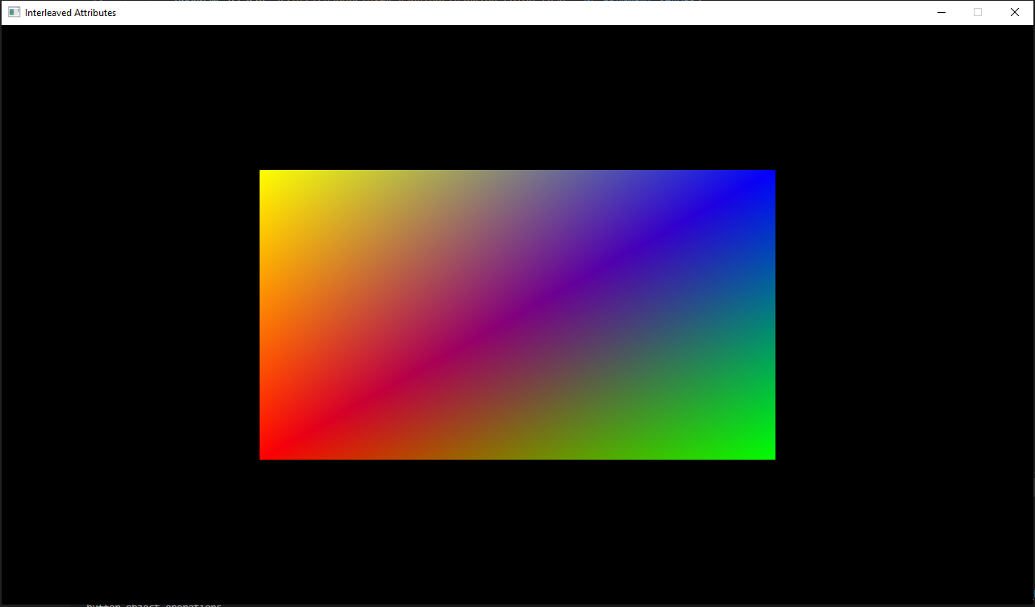
This rectangle is: 2 Triangles 6 vertices

Slide 51
Same vertices different triangles

Slide 52
Enter the concept of elements
Vertex data[] = {
{{-0.5, -0.5, 0.0},{255, 0, 0, 255}},
{{0.5, -0.5, 0.0},{0, 255, 0, 255}},
{{0.5, 0.5, 0.0},{0, 0, 255, 255}},
{{-0.5, 0.5, 0.0},{255, 255, 0, 255}}
};
Each vertex has an index.
A triangle can be defined by the indices of vertices creating them.
uint16_t elements[] = {
0, 1, 2,
2, 3, 0
};

Slide 53
3
2
0
1
Creating a triangle using the vertex index

Slide 54
Generate a buffer to save an elements
glGenBuffers(1, &elements_buffer);
glBindBuffer(GL_ELEMENT_ARRAY_BUFFER, elements_buffer);
glBufferData(GL_ELEMENT_ARRAY_BUFFER, 6*sizeof(uint16_t), elements, GL_STATIC_DRAW);
Vertex Array will store this command as configuration
Type of buffer
Size of data in bytes
Array to be saved in buffer

Slide 55
Drawing
glBindVertexArray(vertex_array);
glDrawElements(GL_TRIANGLES, 6, GL_UNSIGNED_SHORT, (void*)0);
glBindVertexArray(0);

Slide 56
PROJECT

Slide 57
GAME
GAME ENGINE

Slide 58
Project Structure

Slide 59
Concepts
Game States
Resource Acquisition Is Initialization (RAII)
Entity-Component-System (ECS)
Deserialization

Slide 60
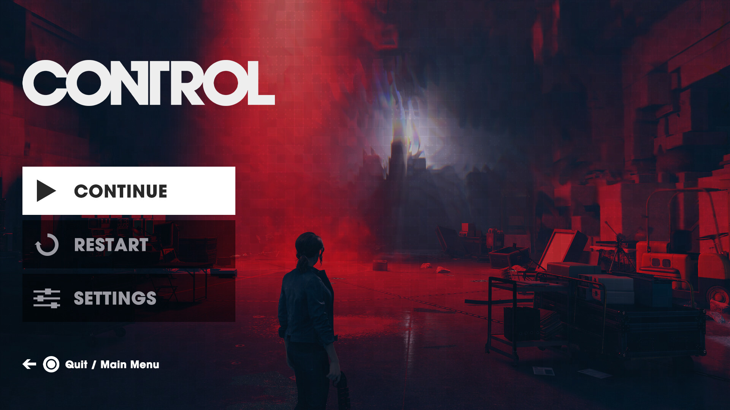
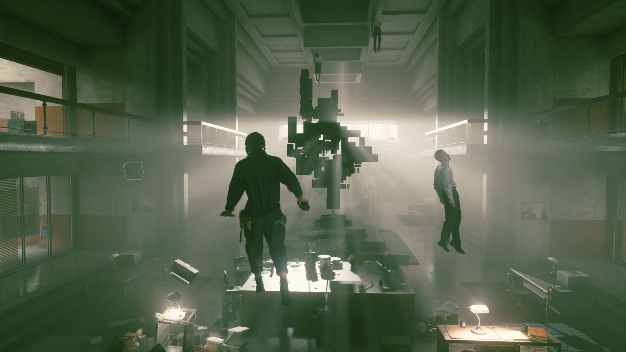
PLAY STATE
MENU STATE

Slide 61

On Enter
On Draw
VIRTUAL
FUNCTIONS
On Exit
STATE MANAGER
CURRENT STATE

Slide 62
On Enter
On Draw
Only switch states on the start or the end of the frame but never in the middle
On Exit
STATE MANAGER
CURRENT STATE
NEXT STATE

Slide 63
Resource Acquisition Is Initialization (RAII)
Bind the resource acquisition and release to the lifetime of an object
Acquire Resource on Construction
Release Resource on Deconstruction
Beware of Copy Constructors and Assignment Operators

Slide 64
Thank you

